Slide 1
SUPERCONDUCTOR

Slide 2
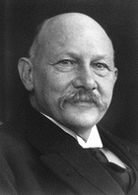
Discoverer of Superconductivity
Superconductivity was first discovered in 1911 by the Dutch physicist,Heike Kammerlingh Onnes.

Slide 3
He successfully liquified helium .
As helium boils at 4.2K ,it therefore possible to study the properties of material at low temp.
In 1911 ,he observed that the electrical resistivity of pure mercury dropped suddenly to zero at about the boiling point of helium.
He concluded that mercury had passed in to new state, which he called the superconducting state.

Slide 4
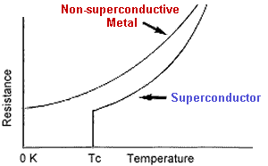
definition………..
T_{c}: This is the critical temperature at which the resistivity of a superconductor goes to zero. Above this temperature the material is non-superconducting, while below it, the material becomes superconducting.
SUPERCONDUCTOR:
A conductor having zero or almost zero resistance is called a superconductor & this phenomenon is called as superconductivity.

Slide 5
Properties of superconductor
zero electrical resistance
Meissner effect
Critical field
Persistent current
Isotope effect

Slide 6
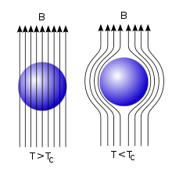
Meissner effect

Slide 7
B=µ0 (H + M) -------------------Normal state
At T< Tc ,B = 0
therefore,
µ0 (H + M) = 0 ------Superconducting state
H + M =0
M= - H
The susceptibility of material= M/H =-1

Slide 8
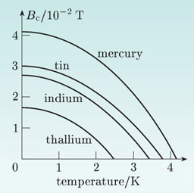
Critical field

Slide 9
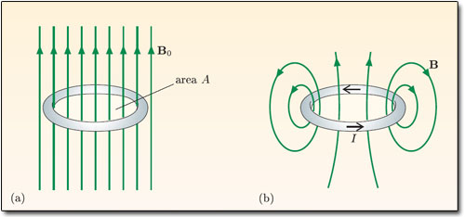
Persistent current

Slide 10
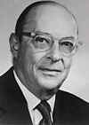
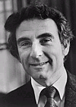
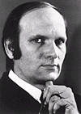
BCS theory
1957 by three American physicists-John Bardeen, Leon Cooper, and John Schrieffer-----------------BCS Theory.
Coulomb attraction between free electron and ions
second free electron passing nearby ,takes advantage of deformation to lower its energy
Electron - Lattice – Electron interaction.
First electron emits phonon absorbed by second electron
In such interaction ,electrons have same energy & equal & opposite spin
Cooper pair
Attraction in cooper pair is very weaK
Can be seperated by increasing temp.
Low temp --→ large density →small velocity for large current →collisions reduced → resistivity decreases
Critical field, Meissner effect ,isotopic effect.

Slide 11
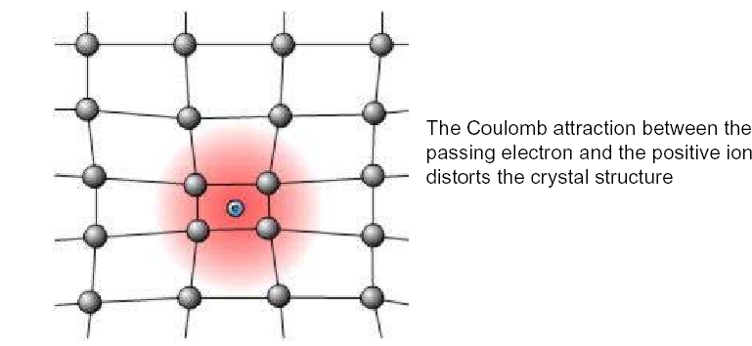
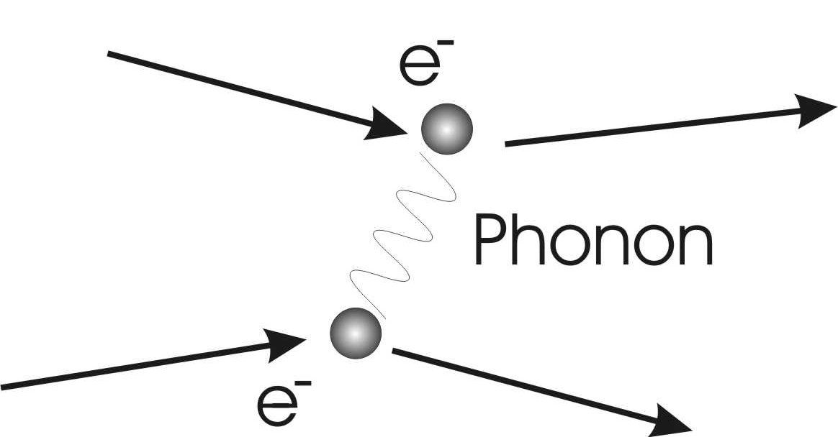

Slide 12
TYPES OF SUPERCONDUCTOR
TYPE I SUPERCONDUCTOR
TYPE II SUPERCONDUCTOR

Slide 13
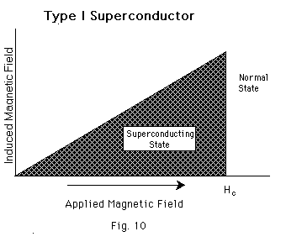
TYPE I SUPERCONDUCTOR
It shows complete Meissner effect.
In type I superconductor ,the transition from a superconducting state to normal state occurs sharply at the critical value H_{c}
magnetization in the specimen is proportional to the applied field and the specimen act as perfect diamagnetic.
H> H_{c} , the magnetization is nigligible and specimen becomes normal conductor.
Also called as soft superconductor.
Example: Aluminium ,Lead.

Slide 14
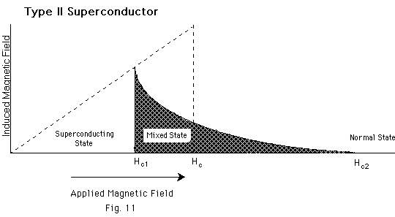
TYPE II SUPERCONDUCTOR
Characterized by two critical fields H_{c1} & H_{c2}
It exists in 3 state-
Superconducting
Mixed
Normal
Hard superconductor

Slide 15
Up to Hc1 , The system is in pure superconducting state . Up to this state , the magnetic flux is completely expelled from the super conductor, the specimen is completely diamagnetic.
After Hc1 and before Hc2 , The system is in Mixed State . In this state ,Maissner effect is incomplete, but ellectrically specimen is superconductor.
Mixed state is also called as Vortex state as the specimen is magnetically mixed, but electrically it is superconductor.
Value of Hc2 is 100 times more than Hc.
Above Hc2,Specimen becomes normal conductor.
It is also called as hard superconductor.

Slide 16
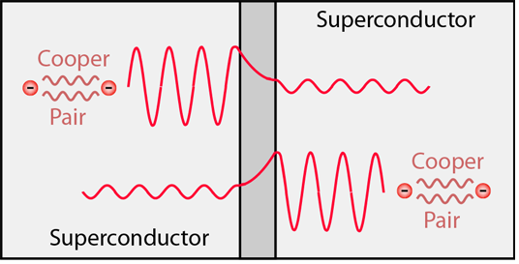
Josephson effect

Slide 17
High temperature superconductor
In 1911,Kamerlingh onnes discovered superconductivity in mercury at critical temp.4.2 k
Till about 1986,the highest critical temp.was observed to be nearly 20k
In 1986,an Oxides of lanthanum ,barium, and copper( La_{1.85} Ba_{0..15} CuO₄ )was observed to have critical temp. of 36K .
In 1987,an Oxides of yttrium ,barium, and copper ( Y Ba₂Cu₃O₇ )was observed to have critical temp. of 90K .
Oxides of thallium ,barium, calcium and copper ( Tl₂ Ba₂ Ca₂Cu₃O₁₀ )was observed to have critical temp. of 120K .

Slide 18
Application of superconductor
Superconducting Magnet
Magnetic Levitation
SQUID
Superconducting Transmission Cable
Bearing
IC Fabrication

Slide 19
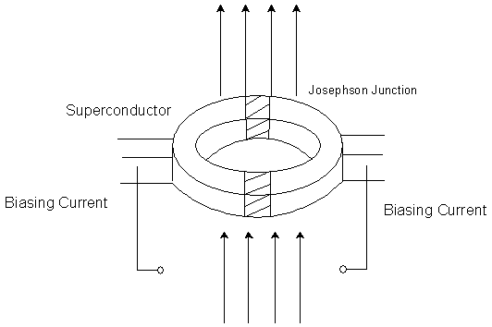
SQUID(Superconducting quantum interference device)

